Slide 1

Predicting Heart Failure with Machine Learning Classifiers
BMEN 619 Project Presentation
Mansi Singhal [30235170]
First Year Master's Student
Department of Biomedical Engineering
12 December 2024

Slide 2

Introduction
What is Heart Failure?
Heart failure is a severe failure of the heart to pump enough blood around the body.
Sysmptoms include:
Breathlessness
Fatigue
Swollen limbs
Notes:
Heart failure is a leading cause of death and morbidity, making early prediction essential for improving patient outcomes.
Machine learning (ML) techniques are increasingly used in healthcare to analyze complex data and identify patterns that assist in early diagnosis.

Slide 3
Project Question
Project Question
How to predict the heart failure in patients using clinical data?
Aim of the Project
​To Predict heart failure outcomes using a dataset with clinical and demographic factors (age, sex, medical history, lab results, etc.) by applying advanced machine learning classifiers

Slide 4
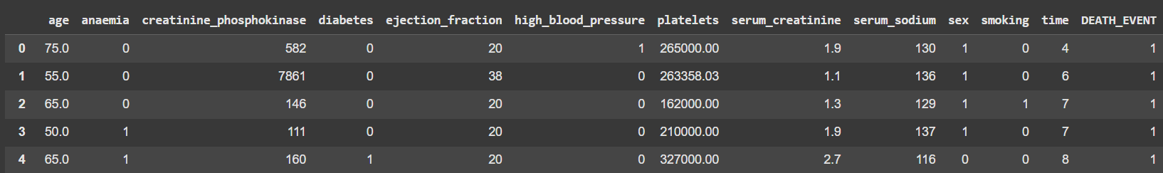
Dataset
Heart Failure Prediction¹
Source : Kaggle
Early Detection & Management: Essential for individuals with high cardiovascular risk factors like hypertension, diabetes, and hyperlipidemia.
Features: 12
Sample Size: 299
Demographic data: Age, Sex
Clinical measurements: Ejection Fraction, High Blood Pressure, Time
Lab test results: Creatinine Phosphokinase, Platelets, Serum Creatinine, Serum Sodium
Symptoms or historical data: Anaemia, Diabetes, Smoking
Target variable: Death Event (e.g., 0 for no, 1 for yes).
Binary Classification Problem
[1] https://archive.ics.uci.edu/ml/datasets/Heart+failure+clinical+records
Notes:
Say downloaded from Kaggle

Slide 5
Dataset Description
age: The age of the patient.
anaemia: Presence of anemia in the patient (1 = Yes, 0 = No).
creatinine_phosphokinase: Level of the enzyme creatinine phosphokinase in the blood (measured in mcg/L).
diabetes: Whether the patient has diabetes (1 = Yes, 0 = No).
ejection_fraction: Percentage of blood leaving the heart with each contraction (measured in percentage).
high_blood_pressure: Whether the patient has high blood pressure (1 = Yes, 0 = No).
platelets: Number of platelets in the blood (measured in kiloplatelets/mL).
serum_creatinine: Level of serum creatinine in the blood (measured in mg/dL).
serum_sodium: Level of serum sodium in the blood (measured in mEq/L).
sex: The biological sex of the patient (1 = Male, 0 = Female).
smoking: Whether the patient smokes (1 = Yes, 0 = No).
time: Follow-up period for the patient (measured in days).
DEATH_EVENT: The target variable indicating if the patient died during the follow-up period (1 = Yes, 0 = No).

Slide 6
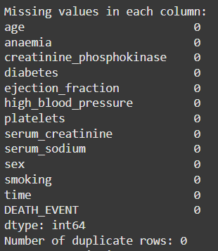
Data Analysis
Preprocessing
Chech the missing values
Duplicated values
Normalization
MinMaxScaler
Cross Validation
applied through GridSearchCV
Used 5-fold CV
Test Split of 20%

Slide 7
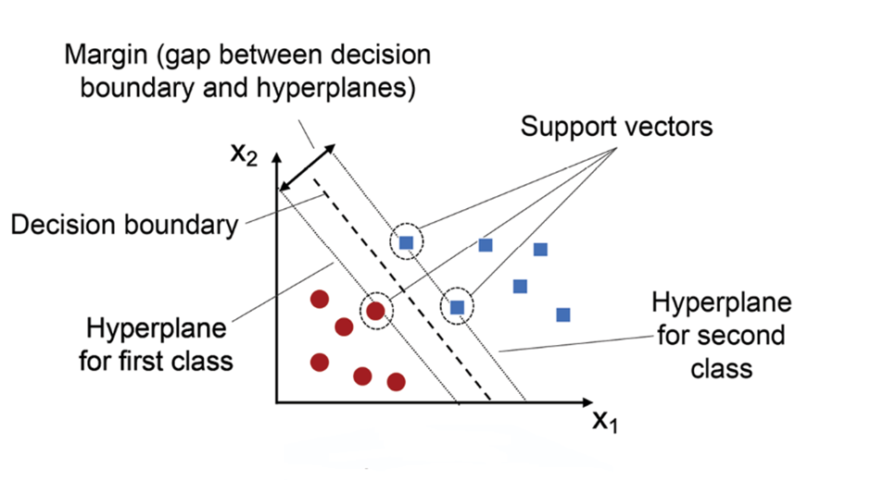
ML Classifier 1: SVM
Support Vector Machine (SVM) is a supervised machine learning algorithm used for classification and regression tasks. It works by finding a hyperplane in an N-dimensional space that best separates the data points of different classes.

Slide 8
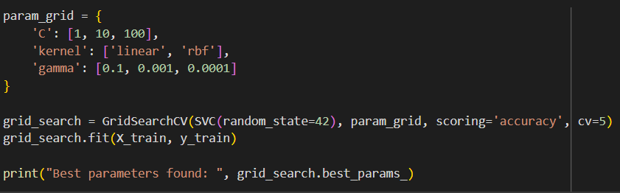
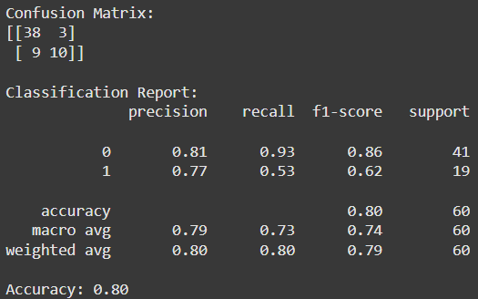
ML Classifier 1: SVM
Best Parameters
C : 1​
kernel : rbf
gamma : 0.1
Accuracy : 80%
Results

Slide 9
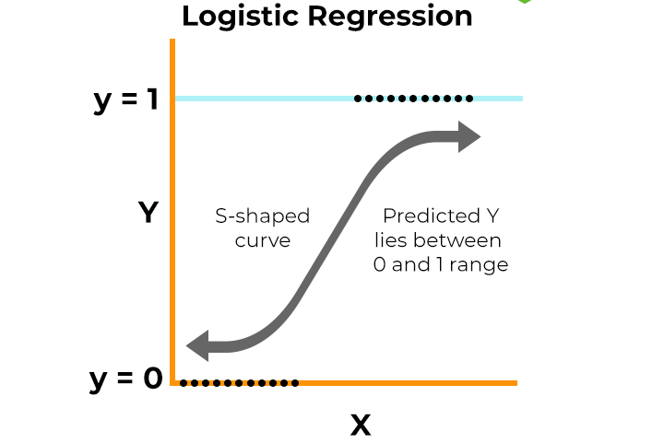
ML Classifier 2: Logistic Regression
Logistic Regression is a statistical method used for binary classification tasks. Despite its name, it is a classification algorithm, not a regression one.

Slide 10
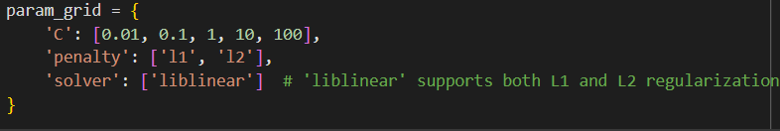
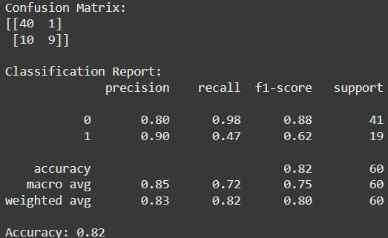
ML Classifier 2: Logistic Regression
Best Parameters​
C : 1
Penalty : l1
Solver : liblinear
​
Accuracy : 82%​
Results​

Slide 11
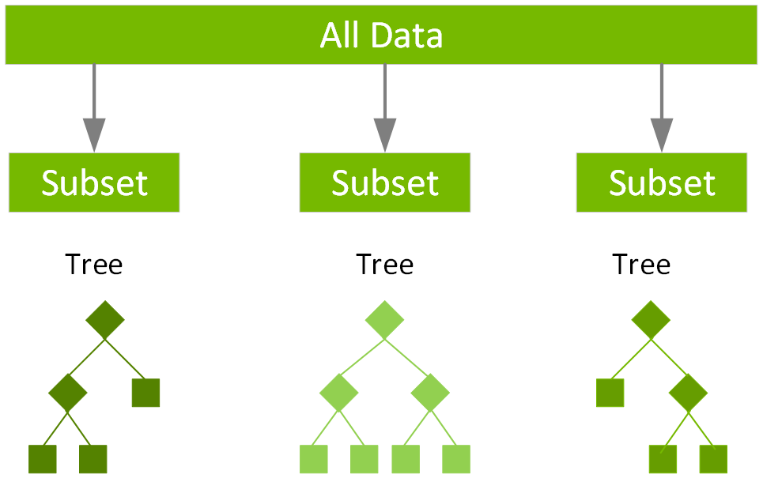
ML Classifier 3: XGBoost
XGBoost (Extreme Gradient Boosting) is a powerful and scalable machine learning algorithm based on the gradient boosting framework. It is widely used for supervised learning tasks, including classification and regression.

Slide 12
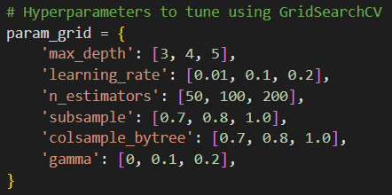
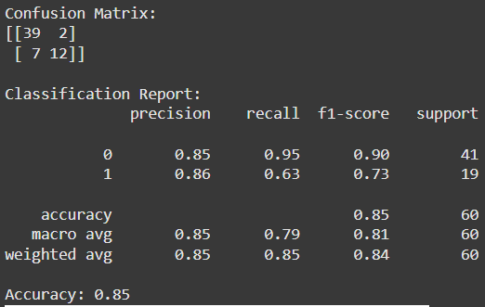
ML Classifier 3: XGBoost
Best Parameters
Results
Colsample_bytree : 0.7
gamma : 0.1
Learning rate : 0.1
Max depth : 4
N estimators : 200
Subsample : 0.7
Accuracy : 85%

Slide 13
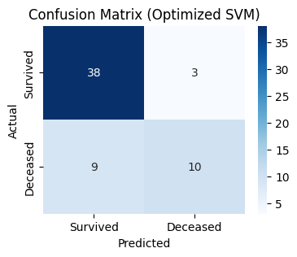
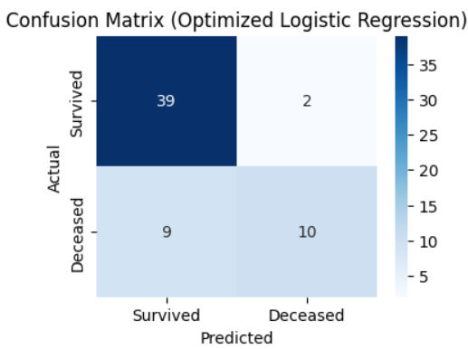
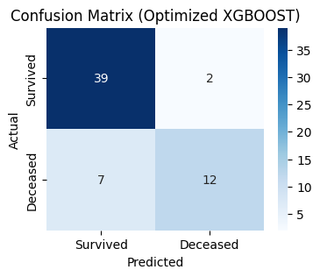
Comparison
SVM Logistic Regression XGBoost
Accuracy : 80%
Accuracy : 82%​
Accuracy : 85%

Slide 14
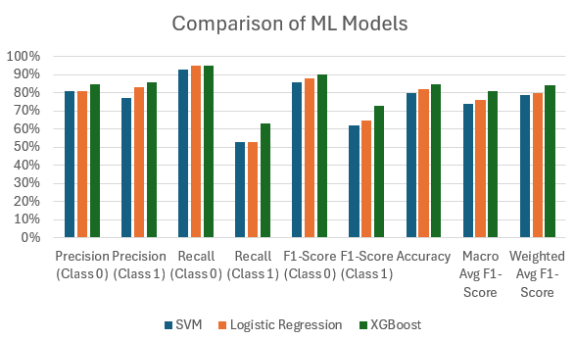
Conclusion
XGBoost: Best overall performance with the highest accuracy (85%) and balanced metrics, particularly excelling in handling the minority class (Class 1). Ideal for datasets requiring accurate predictions for both classes.
Logistic Regression: Strong alternative with 82% accuracy and high precision for Class 1 (83%). Suitable for scenarios prioritizing simplicity, interpretability, and computational efficiency.
SVM: Lowest accuracy (80%) and struggles with the minority class (Class 1, 53% recall). Performs well for the majority class (Class 0) but is less suitable for imbalanced datasets. Useful when Class 0 is more critical.

Slide 15
Future Work
Improve the accuracy by including more iterations for cross validation and other parameters.
Apply this classifiers on different dataset.
Use more advanced ML classifiers on the same dataset.

Slide 16
Thank you

